Slide 1
Pester
The fundamentals
The fundamentals
Marco Kleinert

Slide 2
Devops world
I made a change to my code, does it still work? How can I ensure that the changes I made didn’t break anything?
Luckily there is Pester for PowerShell. A unit testing framework for windows PowerShell.

Slide 3
What is pester, and why should we use it?
an open source unit test framework
> https://github.com/pester/pester
It’s about code quality
And for DevOps: continuous integration

Slide 4

The magic: Describe -> It -> Should
Describe:
Grouping several tests into a same block, and giving it a name.
IT:
What will happen will happen.. here
Should:
The whole mechanism of Pester resides in the piping actions to the “Should” keyword. The expression is then evaluated.

Slide 5
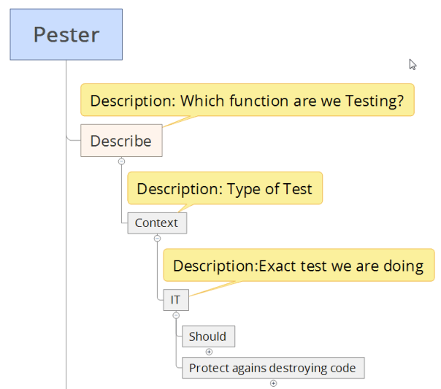
Pester language structure:

Slide 6
Pass or fail: Assertions
An assertion determines if your test passes or fails by taking actual and expected values and comparing them in some way.
Should Be
Should BeExactly
Should BeNullOrEmpty
Should Match
Should MatchExactly
Should Exist
Should Contain
Should ContainExactly
Should Throw
… > https://github.com/pester/Pester/tree/master/Functions/Assertions

